Slide 1


Prepare Respond Recover
Assisting facilities, institutions, companies and governments Prepare, Respond & Recover from pandemics
We help create safe environments for public health

Slide 2

Who are we?
ISSA is the worldwide cleaning industry trade association. As a global nonprofit, we have 9,300 member companies spread across 105 countries.
GBAC, a division of ISSA (GLOBAL BIORISK ADVISORY COUNCIL) is staffed with experience in academia such as Harvard, Penn State, Emory University, and USA Governmental Agencies.
GBAC was created specifically to deal with pandemics such as we are experiencing today with absolute effectiveness and absolute integrity.
7,125
605
648
370
164
317
125
Setting standards in training the cleaning industry & biorisk market
Making the connection between human health and cleaning
Represent more than 9,300 corporate members in 105 countries

Slide 3














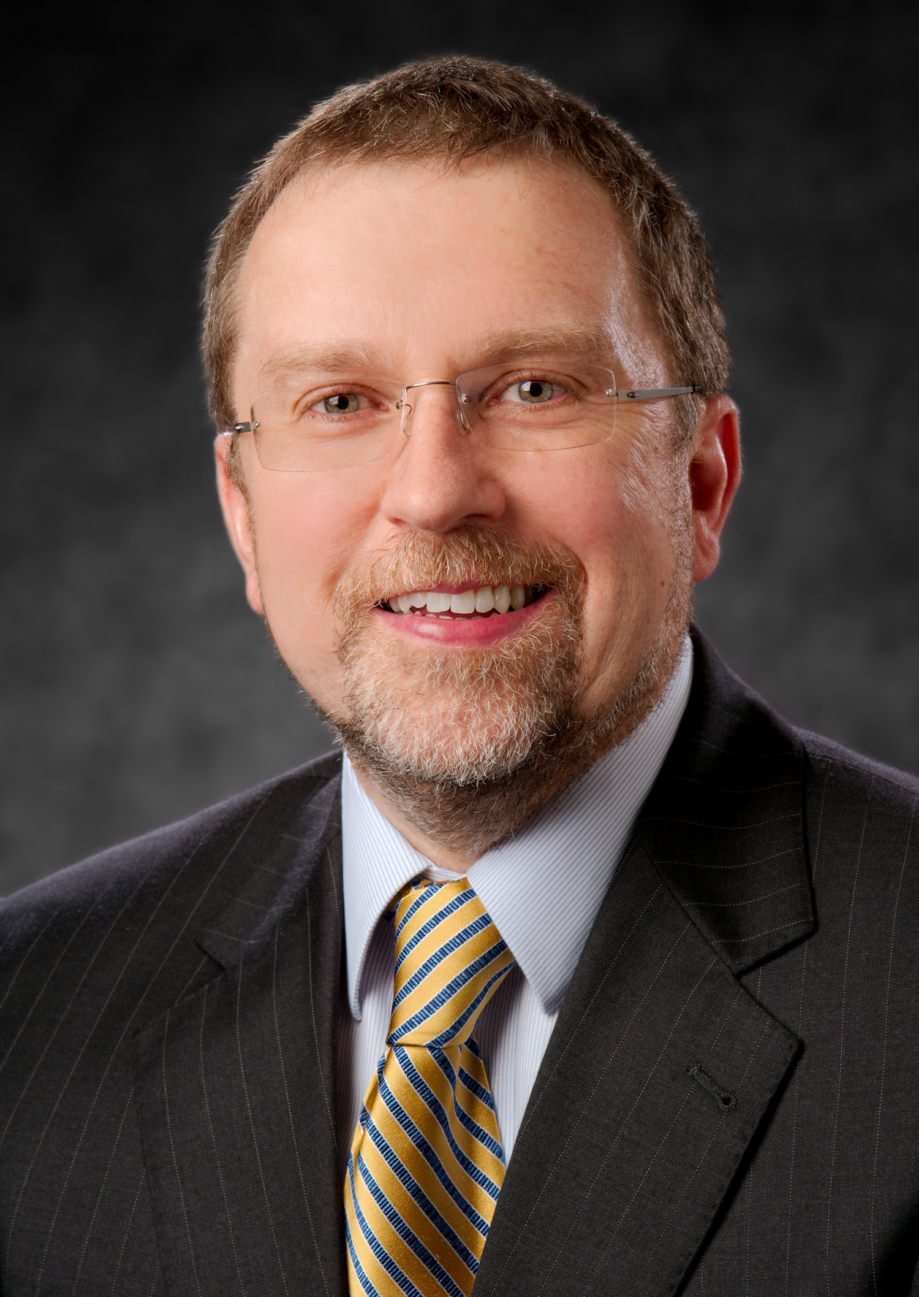



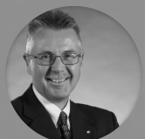




Scientific Advisory Board & Affiliations
The Global Biorisk Advisory Council is comprised of global leaders in the area of microbial -pathogenic threat analysis and mitigation. With hundreds of years in collective experience.
[View complete Advisory Board]
Patricia Olinger, JM, RBP
GBAC Executive Director
Gavin Macgregor-Skinner, BVSc, MSc, MPH, MRCVS
Certified Forensic Operator®,
Certified Bio-Forensic Restoration Specialist®
Paul J. Meechan, Ph.D, MPH, RBP, CBSP, SM(NRCM)
Certified Forensic Operator® Certified Bio-Forensic Restoration Specialist®
Stefan Wagener, PhD, SM (NRCM), CBSP, RBP®

Slide 4
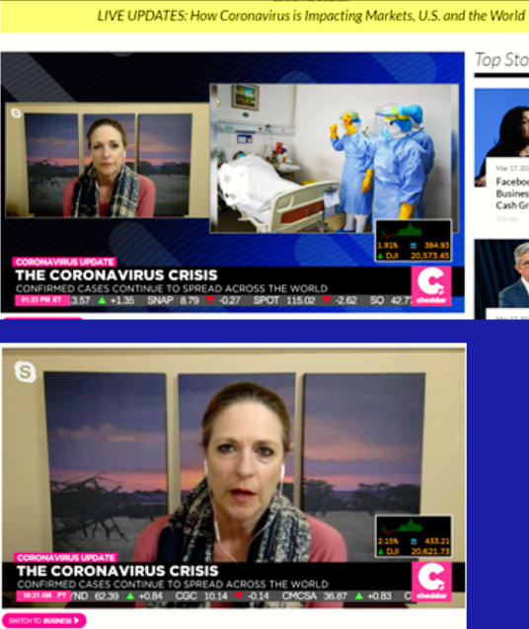
Meet Patricia
Ms. Patricia (Patty) Olinger is the Executive Director of GBAC, the Global BioRisk Advisory Council, a new division within ISSA. GBAC is recognized as a leader in training, education, and certification in Forensic Restoration®, Biorisk management, decontamination and infection control disciplines. GBAC as a division of ISSA addresses a market need for advanced knowledge and application of science-based cleaning, disinfection and infection-control practices worldwide supporting ISSA’s commitment to change the way the world views cleaning.
Previous to joining ISSA-GBAC, Ms. Olinger was an Assistant Vice President in the Office of Research Administration and the Executive Director of the Environmental, Health and Safety Office (EHSO) at Emory University. During Ms. Olinger’s 13-year tenure, EHSO had University-wide responsibility for all aspects of Environmental, Health and Safety support, including EHS compliance support to Emory Healthcare. This included Biosafety support to the Emory Serious Communicable Diseases Unit (SCDU), which cared for 4 Ebola patients in 2014. Prior to joining Emory in 2006, Ms. Olinger spent 21 years in the Pharmaceutical Industry, providing support to both human and animal health research developing a true OneHealth perspective.
From 2013-2018, Ms. Olinger supported the Elizabeth R. Griffin Foundation, acting as their Director of Global Projects. In this role, she led international biorisk management projects, obtaining practical experience with staff and facilities in extremely low resource environments worldwide. She has facilitated the development of local leadership for assessing and enhancing capacity in both laboratory and healthcare environments. Through safe, secure, practical and sustainable ways, strengthening their Biorisk Management capacities, supporting Global Health Security.
Ms. Olinger is a Registered Biosafety Professional, a Certified Forensic Operator and a Certified Bio-Forensic Restoration Specialist. She has supported the development of International Biorisk Management Systems from the conception of the CWA 15793:2011 and is the current Deputy Convener of the ISO Working Group that is developing the ISO International Biorisk Management Standard ISO 35001. She served as a member of the External Laboratory Safety Working Group to the Director of CDC, the APLU/AAU Laboratory Safety Taskforce, was a council member of the American Biological Safety Association (ABSA), a former Scientific Advisory Board member of the U.S. NIH National Biosafety and Biocontainment Training Program (NBBTP) and is a past President of the Campus Safety Health and Environmental Management Association (CSHEMA). Ms. Olinger has a BS in Biochemistry and a Masters of Law with a focus on International Global Health. Patty has a true passion in Global Health Biorisk Management Preparedness, Response and Recovery.
Patricia Olinger, JM, RBP
GBAC Executive Director

Slide 5
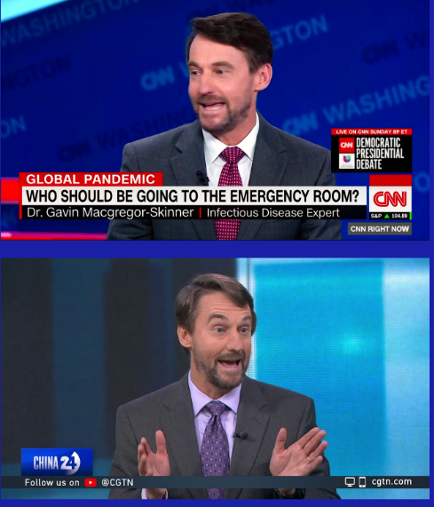
Meet Gavin
Dr. Macgregor-Skinner has more than 25 years of technical experience in emergency management and infectious disease surveillance and response and has worked with U.S. and international governments, United Nations agencies, and the private sector in the U.S., Africa, Asia, Middle East, and Latin America. He is an assistant professor in the Department of Public Health Sciences at Penn State Hershey College of Medicine and Director of Global Disaster Response for the BIDMC Fellowship in Disaster Medicine affiliated with Harvard Medical School.
He has appeared on CNN, BBC, Canada CTV, Australia ABC, C-SPAN, and other news outlets to share his expertise on Ebola, Influenza, Measles, Cholera, Zika outbreaks and other global health threats. After serving in the Australian and British militaries, he was selected by the U.K. Department for International Development for its Associate Professional Officer Scheme.
He learned epidemiology as an epidemic intelligence service officer at the U.S. CDC and was a global health fellow at USAID. His passion is engaging networks of experts who share knowledge and experiences to risk the global understanding of risk and safety.
Gavin Macgregor-Skinner, BVSc, MSc, MPH, MRCVS
Certified Forensic Operator®,
Certified Bio-Forensic Restoration Specialist®

Slide 6
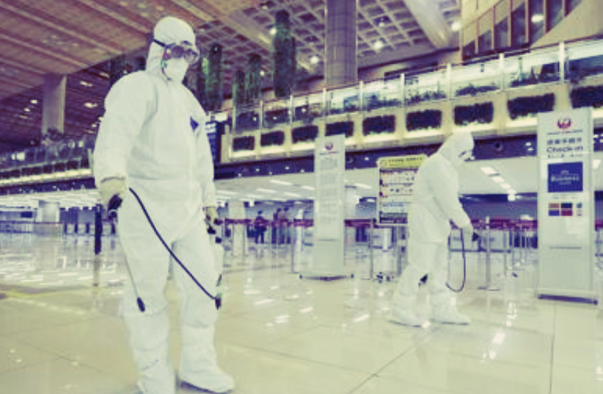

Real Concerns:
Disinfection & Pandemics
(COVID-19)
How can we protect building occupants now and in the future?
Cleaning for infectious disease - how?
Where are? The best practices for limiting the impact of future outbreaks and pandemics?

Slide 7
How does GBAC help organizations respond and recover from the current and future crisis?
GBAC STAR provides confidence, trust, and third-party validation that facilities are safe!
We all know that the new normal will require higher levels of cleanliness. This is the solution for occupants to KNOW that they are in a SAFE FACILITY.

Slide 8

GBAC STAR – What is it?

Slide 9
GBAC STAR – What does it mean?
It means that YOUR facility staff or service provider is implementing the industry’s highest standards for Cleaning, Disinfection and Infectious Disease Prevention (COVID-19)!
Proper Training
Accurate
Chemistry
Appropriate
Equipment
Proper
Tools
Standard
PPE
Proper Procedures

Slide 10



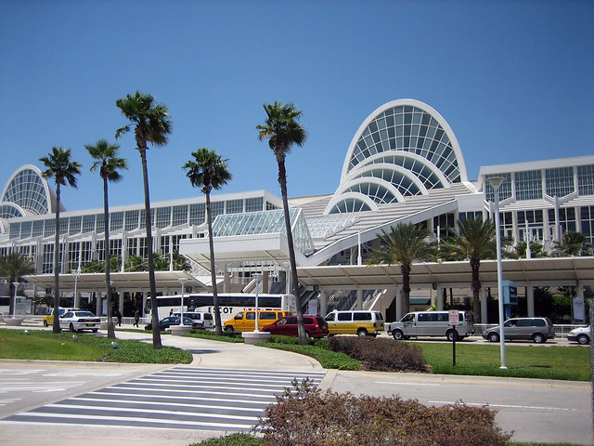


GBAC STAR – Who is this for?
GBAC STAR Facility Accreditation
Who is this for? Stadiums, convention centers, retail space, commercial offices, daycares, athletic clubs, schools, assisted care facilities, vet clinics, restaurants, hotels, spas, trains, planes, churches, distributors, the list goes on…..
ALL FACILITIES – EVERYONE WHO CONSIDERS PUBLIC HEALTH IMPORTANT

Slide 11
GBAC STAR – How?
GBAC STARTM program is a performance-based program. GBAC will assist with a suite of opportunities to help facilities in developing the competencies, procedures and tools to meet the requirements of the program. Learning together, making the world a better place.
Facility decides to obtain GBAC STAR Accreditation
Facility submits application & deposit
Facility will receive Accreditation Handbook and implementation guides
Facility may now announce the pursuit of GBAC STAR
Facility submits accreditation documentation and GBAC Technical team review for compliance
Facility now qualifies for the accreditation of GBAC STAR; Balance Due
GBAC STAR Achieved!
Step 1
Step 2
Step 3
Step 4
Step 5
Step 6

Slide 12
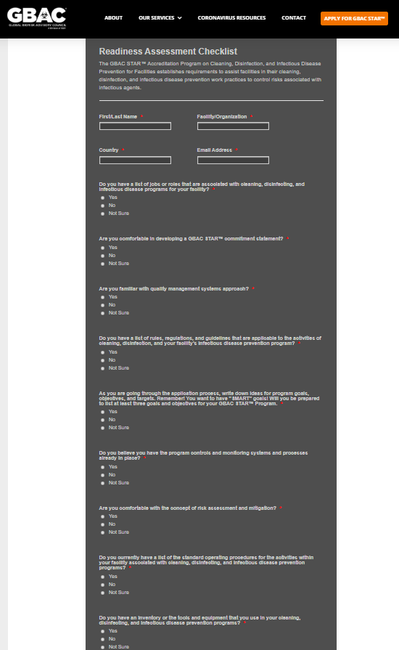
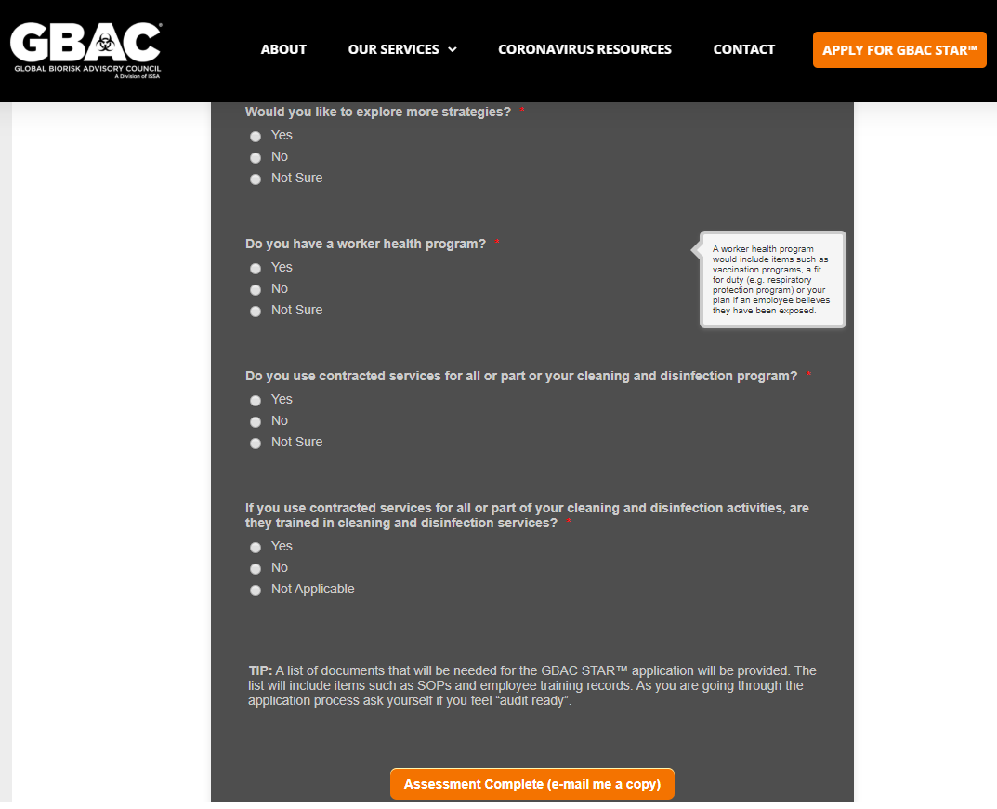
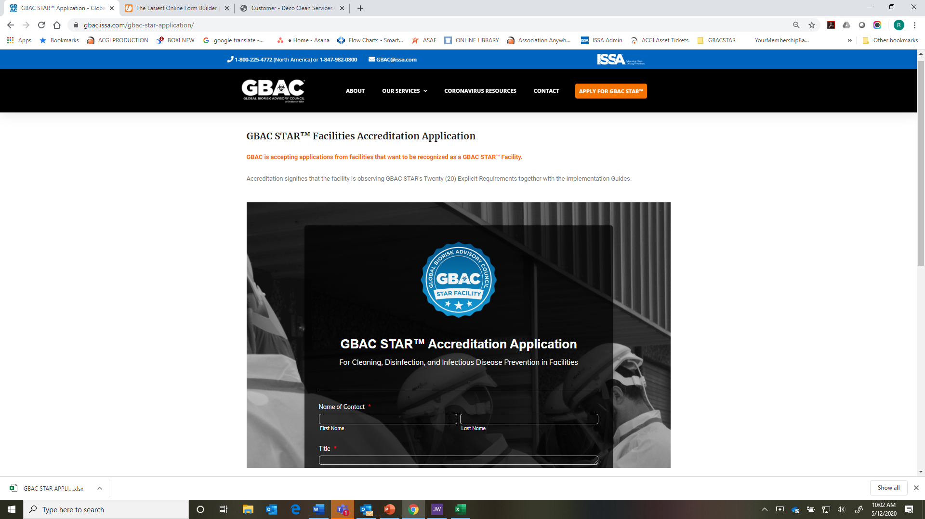
GBAC STAR – Readiness Assessment

Slide 13
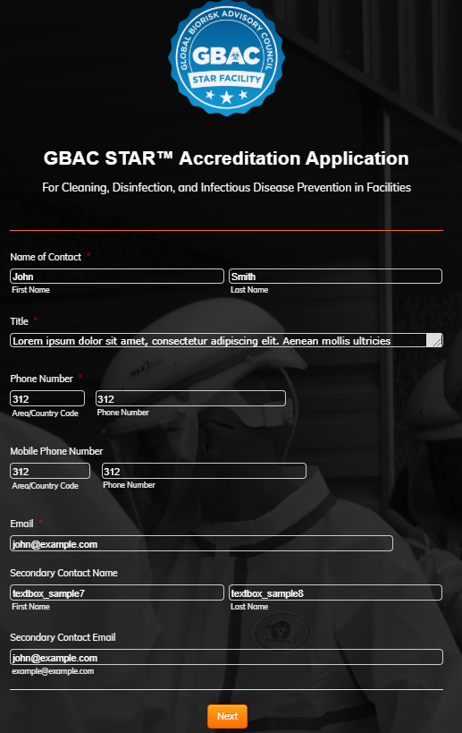
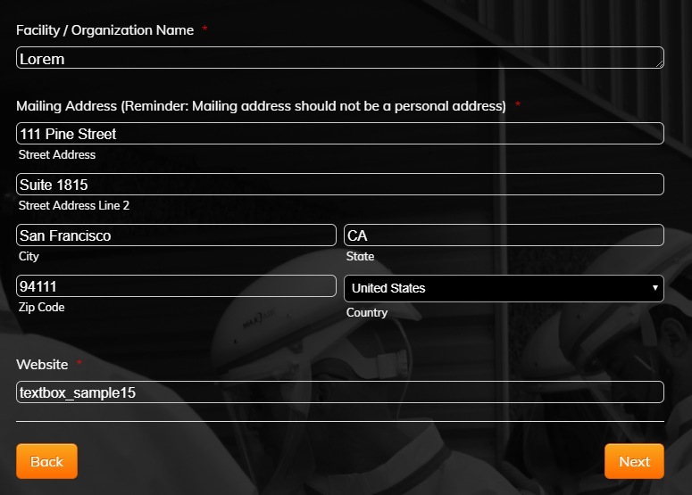
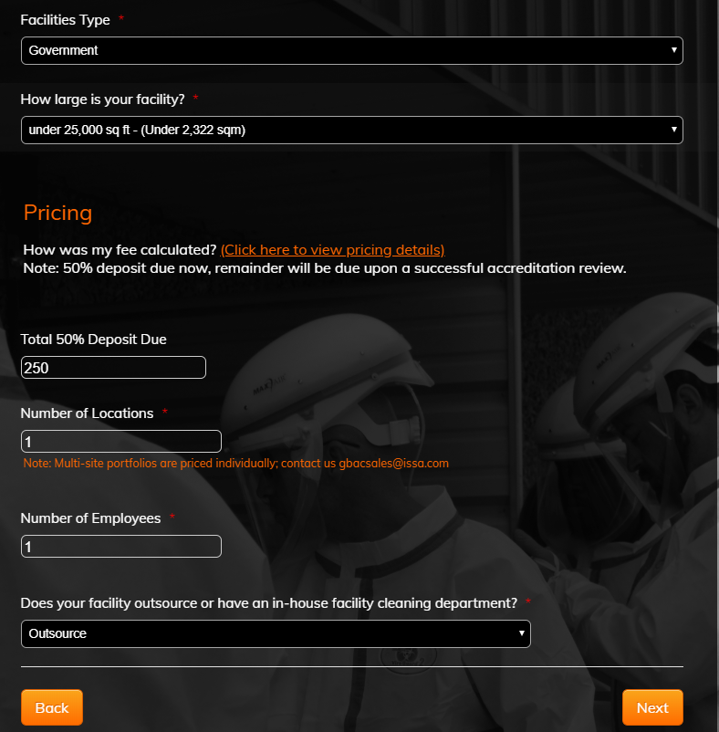
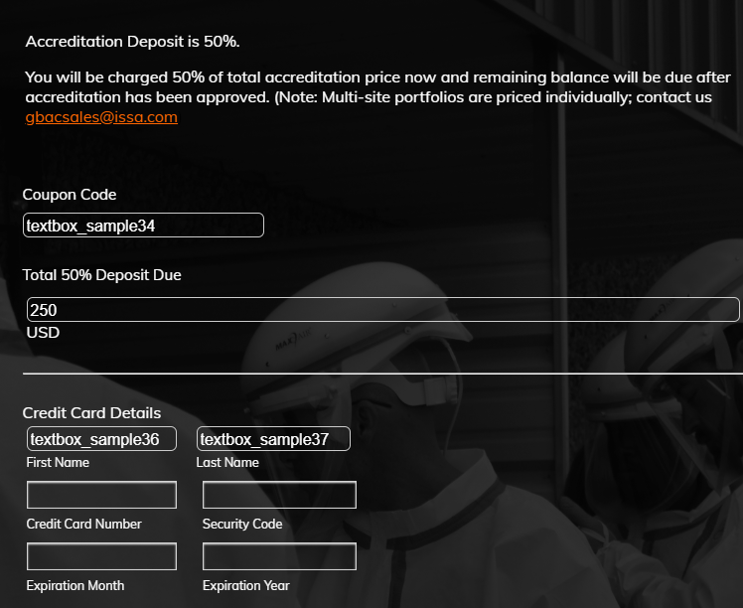
GBAC STAR – APPLICATION

Slide 14
GBAC STAR – Following Application Submission
Step 1: Review the Recommendations for a successful accreditation process
Step 2: Download the GBAC STAR™ Accreditation Handbook and share with your Project Team
Step 3: Download and review the Accreditation Resources
Step 4: Establish Project Schedule - (reference STEP 1 for details)
Step 5: Save all project documentation in one central location for easy upload process
Step 6: Review all documents listed in handbook are gathered and begin upload process.
Step 7: Claim your online courses. GBAC Fundamentals Online Course

Slide 15
GBAC STAR – Final Stages
Upon submission of all required documentation, the GBAC Quality Assurance team will review for accuracy and compliance. The length of the assessment depends on the size of the facility and regions covered, which can take anywhere between 2 weeks and 4 weeks for a final decision to be made.
What next?
Upon review and all requirements are met, your facility will qualify for the accreditation of GBAC STAR and will receive notice of qualification.
You will then receive your final invoice for the Accreditation Fee balance due.
A facility’s accreditation becomes effective upon a letter of approval by the GBAC Quality Assurance Team and payment in full of the accreditation fee.
The date that you obtain your accreditation is known as your anniversary date. The initial accreditation is valid for one (1) year from that date. All renewals are based on the accreditation date.

Slide 16
GBAC STAR Accreditation Includes:
Restaurants: 1 per 100 seats
Arenas: 1 per $1,000 of fee
All other facilities: 1 per $1,000 of fee
Hotels: 1 per 100 rooms
ISSA Annual Membership
GBAC Online Fundamentals Course: Cleaning & Disinfection Principles
This course teaches cleaning professionals to prepare for, respond to and recover from biohazards in the workplace. Participants will learn infection and contamination control measures for infectious disease outbreak situations such as the novel coronavirus (SARS-CoV-2).
Individuals who successfully complete the course within 30 days will receive a Certificate of Completion from the Global Biorisk Advisory Council (GBAC), a division of ISSA.
GBAC trains workers to be Microbial Warriors™, arming cleaning professionals with the planning, knowledge and processes needed to respond to a biohazard crisis in the workplace.

Slide 17

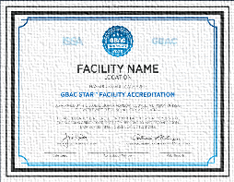
GBAC STAR Accreditation Kit:
Official Approval Letter
Certificate
Year Specific Accreditation Seal & Decal
Access to GBAC STAR Facility Portal
High Resolution Facility Seal
Press Release Template
Social Media Template
Bios
Boilerplates
Official Statements
Program Overview
GBAC STAR Store

Slide 18

3300 Dundee Rd.
Northbrook, IL 60062
Phone: 847-982-0800
Website: www.gbac.org
Email: gbac@issa.com

